Slide 1

Contrastive Explanations
What is it? What does it do? How does it work?
By Vitor Vicente of Team #9

Slide 2
Quick Rundown
Think in terms of counterfactuals.
What would have happened if you took the opposite choice?
Example:
Actual Occurrence: I took a sip of my coffee, so I burnt my tongue.
Counterfactual: If I hadn’t taken a sip of my coffee, I wouldn’t have burnt my tongue.
IN CS/DS:
“A counterfactual explanation of a prediction describes the smallest change to the the feature values (input) that changes the prediction to a predefined output.”
IE: What small input needs changing to just flip the answer

Slide 3
In Practice
Use Contrastive Explainer to figure out why the model predicts X instead of Y.
Why us it: Clear the Blackbox that sometimes comes from ML
How does it do it?
Contrastive Explainers attempt to find the point(s) at which some feature makes the answer Flip from one to another, and returns that point(s)
IE: Uses Counterfactual Logic

Slide 4
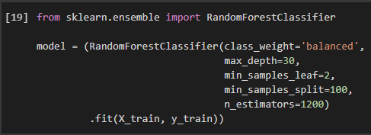
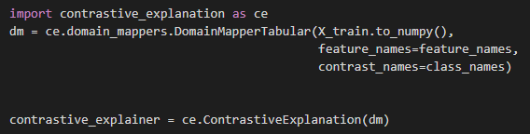
Model vs Explainer
Model:
Get fed Train Data (features+outcome) to train itself
Then is run on independent Data (features only)
Gives an outcome based on its training (this is an oversimplification for the sake of this comparison)
Explainer
Gets fed the trained Model itself + Train Data (features only)
Gets run on a Specific Instance of Independent Data (features only)
Attempts to give a mathematical/logical explanation as to why the Model classified that Instance as it did

Slide 5
Current Example
Features in the data:
RevolvingUtilizationOfUnsecuredLines
Age
DebtRatio
MonthlyIncome
NumberOfOpenCreditLinesAndLoans
NumberRealEstateLoansOrLines
NumberOfDependents
NumberOfTimeDaysPastDue
SeriousDlqin2yrs
Model Outcome:
SeriousDlqin2yrs
IE: Is it a good idea to invest in the individual?
Explainer Outcome
{ANY FEATURE} : {BARRIER AT WHICH IF CHANGES} …
IE: Why it is (or isn’t) a good idea to invest in the individual?

